Slide 1
OneWorld AI
World Model for Post-Training in Physical Domains
Sherry Yang
NYU/Google DeepMind
Hieu Pham
OpenAI

Slide 2


The Post-Training Gap
GPT-3 wasn’t usable until RLHF - we need post-training
Pretraining
SFT
Reward Model
RL

Slide 3


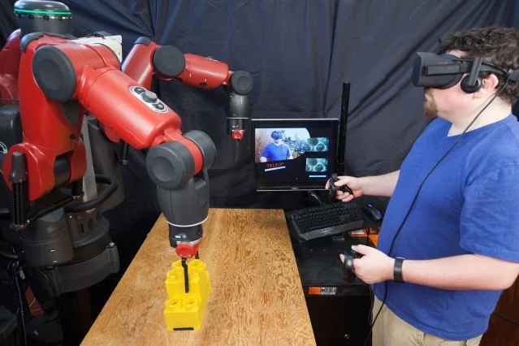



The Post-Training Gap
Existing robot companies not closing the post-training gap
Robot companies
Robot data companies
Pretraining
SFT
Reward Model
RL

Slide 4


The Post-Training Gap
We build post-training for physical domains
Robot companies
Robot data companies
Us
OneWorld
Pretraining
SFT
Reward Model
RL

Slide 5
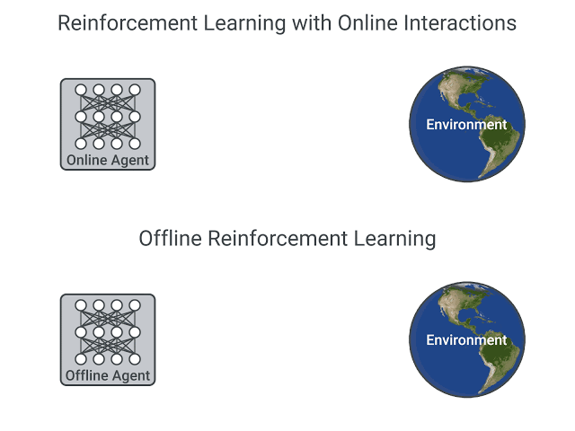
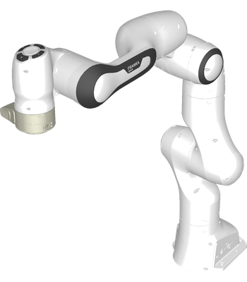
Why is Physical Post-Training Hard
Can’t do RL in the physical world world
Need to run physical robot to get reward (one action at a time)
Settings are limited to the physical scene (one scene at a time)
Physical World

Slide 6
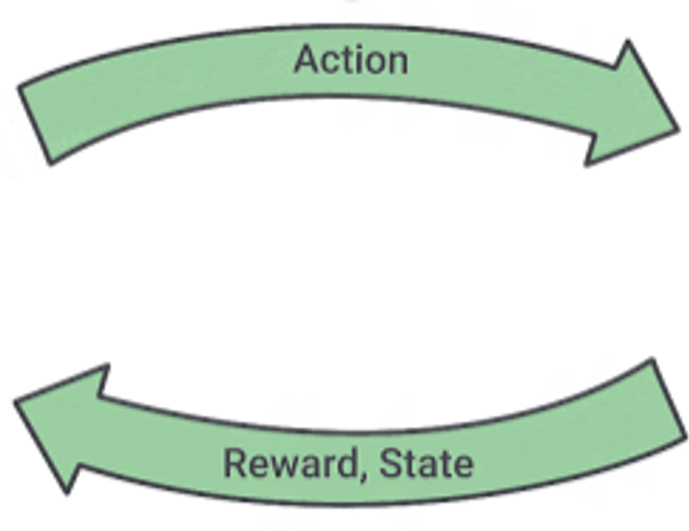
Our Solution: World Model
A world model is learned from data and runs in the cloud
Can be queried in parallel
Can simulate an arbitrary scene
World Model
OneWorld

Slide 7
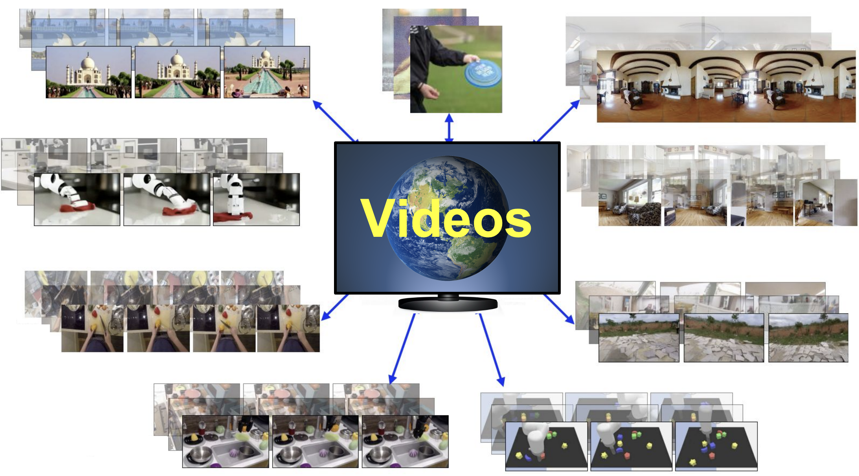
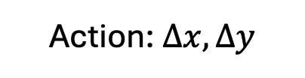
Our Solution: World Model
A world model takes observations and actions and generates videos
Observation (image)
Generated video
OneWorld
Action: $Δx, Δy$

Slide 8
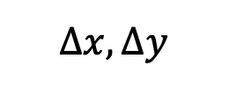
Our Solution: World Model
A world model provides an RL environment to train robot policies
Generated video
$Δx, Δy$
OneWorld
Reward Model
Fail ✕
Reinforcement learning
Success ✓

Slide 9
The Tech
Pretraining the Best World Model

Slide 10
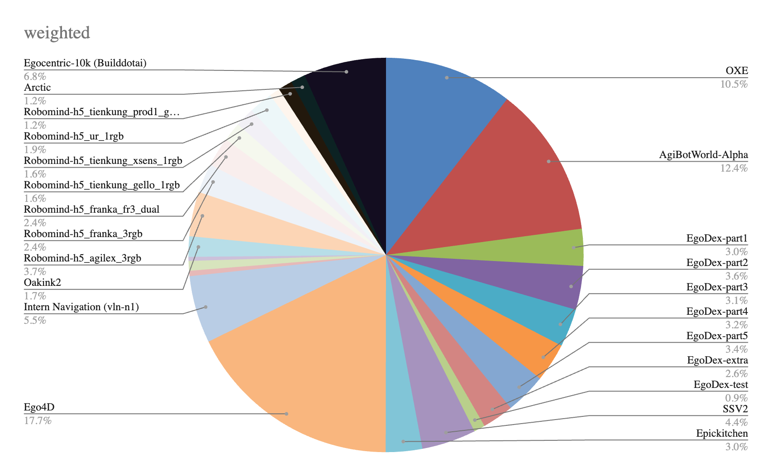
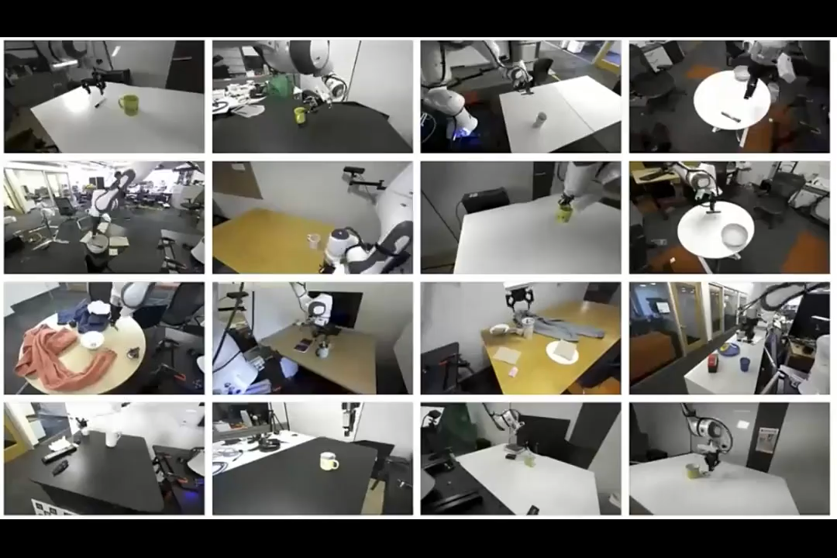
Scaling World Model Pretraining Data
We will curate the best world model pretraining dataset
We have curated diverse interactive datasets from humans and robots

Slide 11
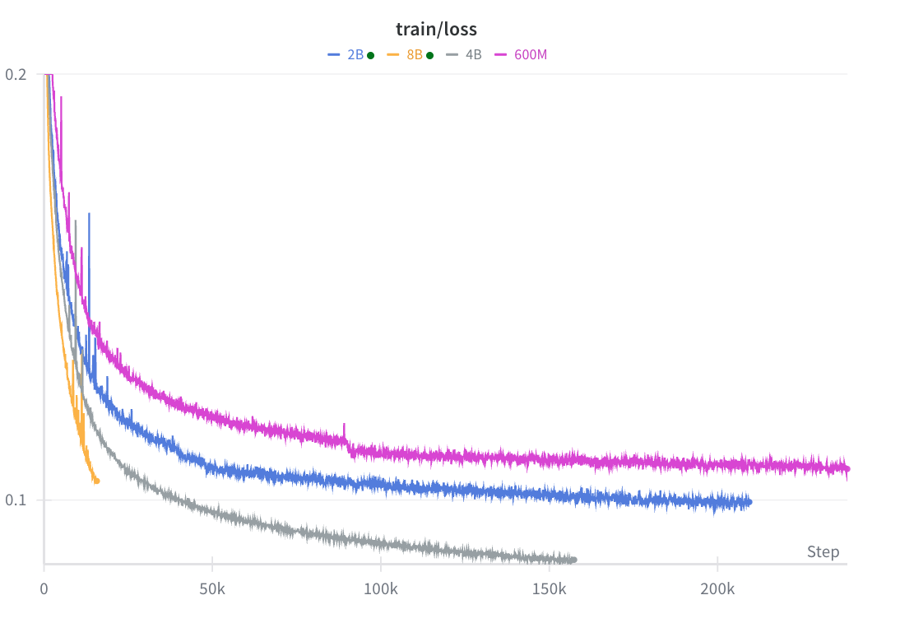
Scaling World Model Parameters
We will build the largest and best foundation world model
Like LLMs, our world model scales favorably
Training Loss

Slide 12
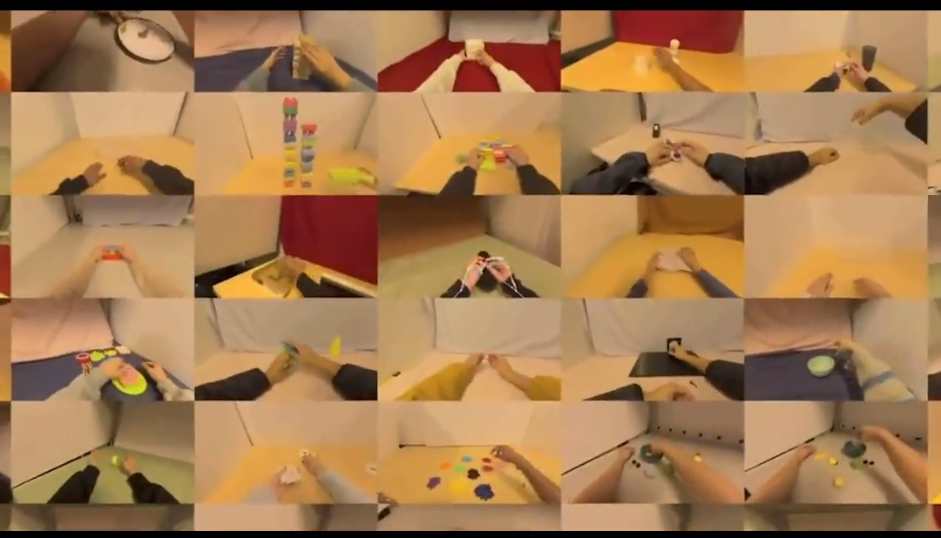
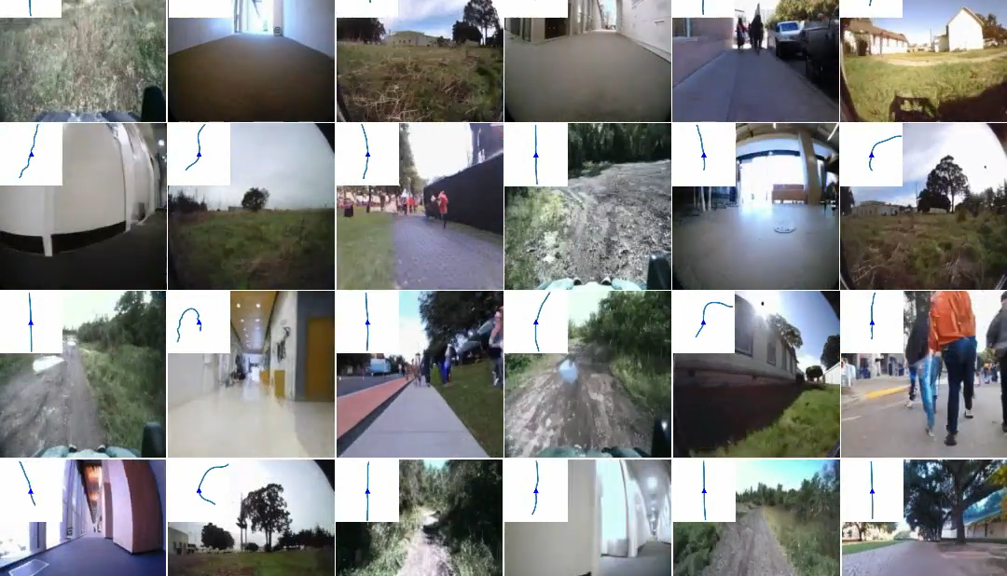
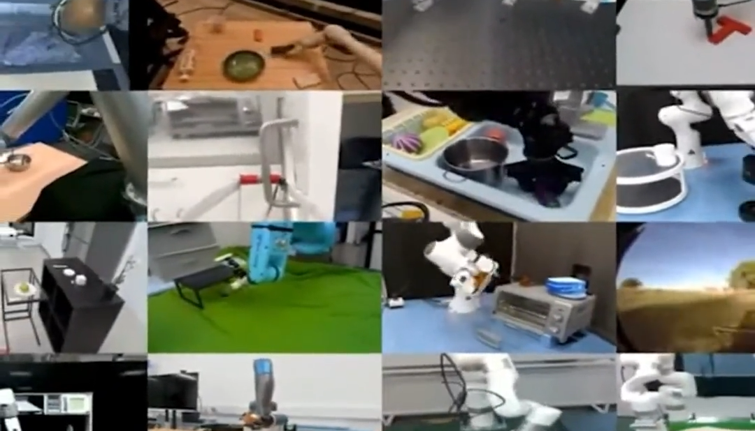
Building RL Infrastructure
Robot companies
Enable
Central engine of the ecosystem
OneWorld (World Model + RL Environment)
Compute (GPUs)

Slide 13
Demos
World Creation and RL Training

Slide 14
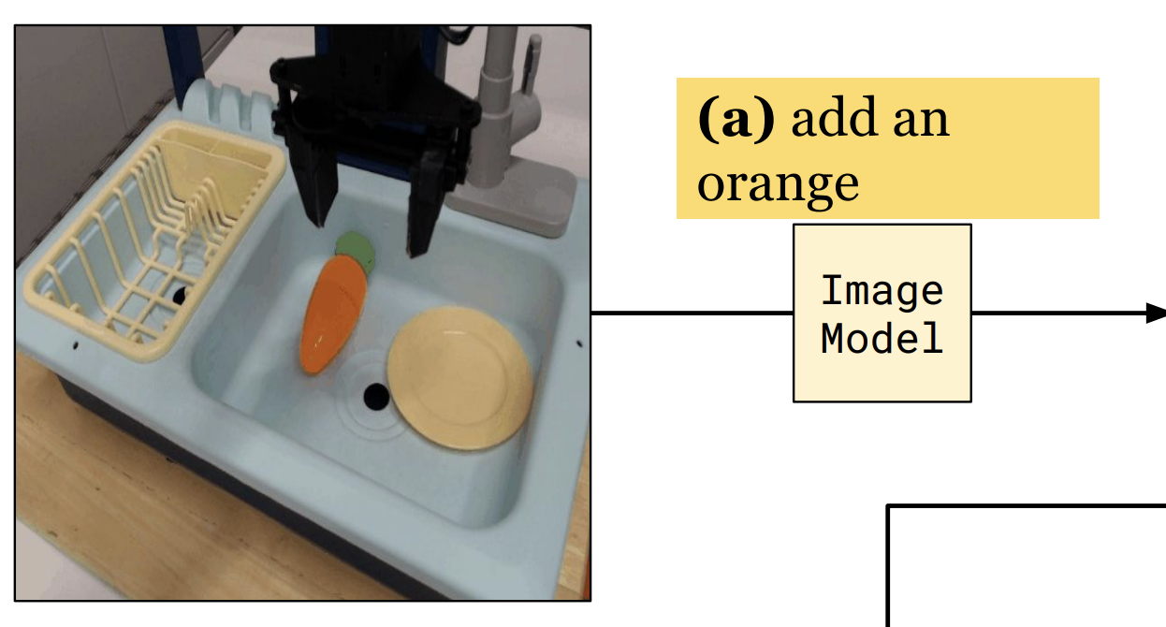
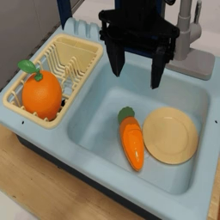
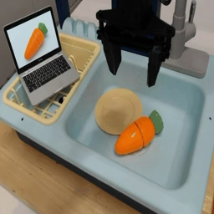
Task Creation in Our World Model
Our world model generates infinite novel scenarios and rewards
Pick up orange
Pick up carrot

Slide 15
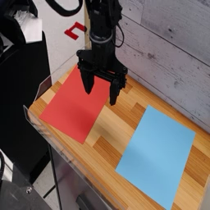
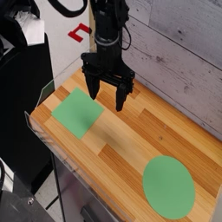
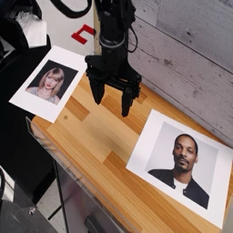
Task Creation in Our World Model
Our world model generates infinite novel scenarios and rewards
Pick red
Pick circle
Pick Taylor Swift

Slide 16
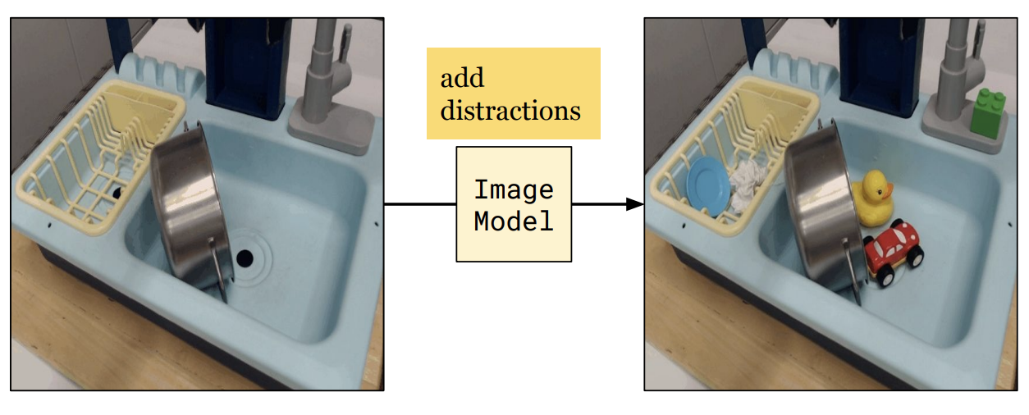
RL Training in Our World Model
Before RL training, VLA policies fail to generalize
Test
Train

Slide 17
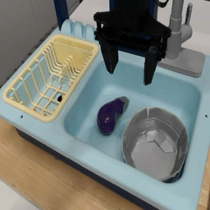
RL Training in Our World Model
After RL training, a robot policy improves drastically (measured on real robot)
Used by RL
Real-robot success rate
A successful rollout in our world model
A failed rollout in our world model

Slide 18
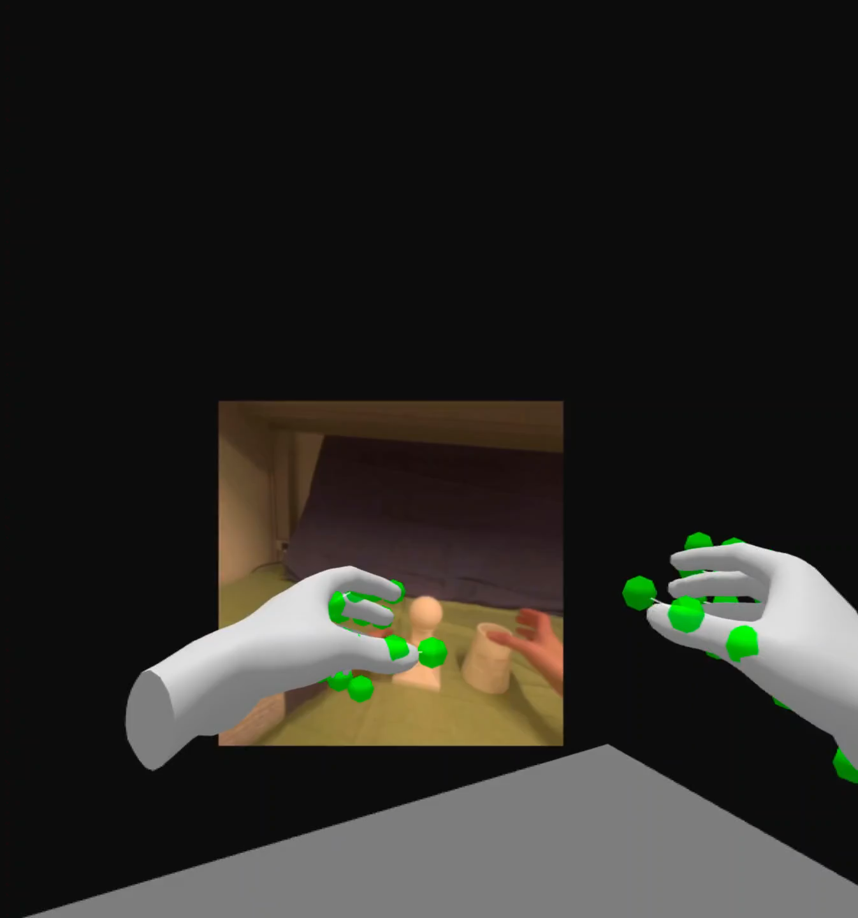
Simulating Human(oid) Interactions
Our world model can simulate interactions from humans and future humanoid robots

Slide 19
Summary
Our role: Central engine for post-training in the physical domain
Enable robot companies to train/evaluate robots in the cloud
Our technology
Pretrained the best world model (data, model scaling)
RL infrastructure
Our current evidence
World model pretraining scales favorably
Novel scenarios in a world model
RL in a world model transfers to better real-robot performance
Notes:
We are a new category of company. Pretraining world model through scaling. Enabler and central engine for robot companies.

Slide 20
Business: World Model and Infrastructure as a Service
Service | Customer | Product
Evaluation as a Service (API) | Customers who want to evaluate their policies | Robot companies pay to “test” their bots in our worlds
Training and inference infrastructure | Customers who want custom policies based on their needs | We sell “training hours” in our world model
Generalist policy | Customers who don't want to invest in training policies (robot hardware companies) | We sell the best in-house policy trained in our world model

Slide 21
Why We Will Win
Segregated world model training data
No party has it all
Who acts now will build the best world model
The pretraining lead
We have the scaling curves and architecture. Catching up requires massive compute and data
Data flywheel
Companies that use our service will produce more data to refine our world model
Notes:
We are a new category of company. Pretraining world model through scaling. Enabler and central engine for robot companies.

Slide 22


Why the Team
Sherry Yang
Hieu Pham
Have been building world models since 2023 (ICLR best paper on video as world model)
Infra and kernels at xAI/OpenAI

Slide 23
Ask & Vision
Investing in the infrastructure that powers the next generation of physical AI

